Slide 1

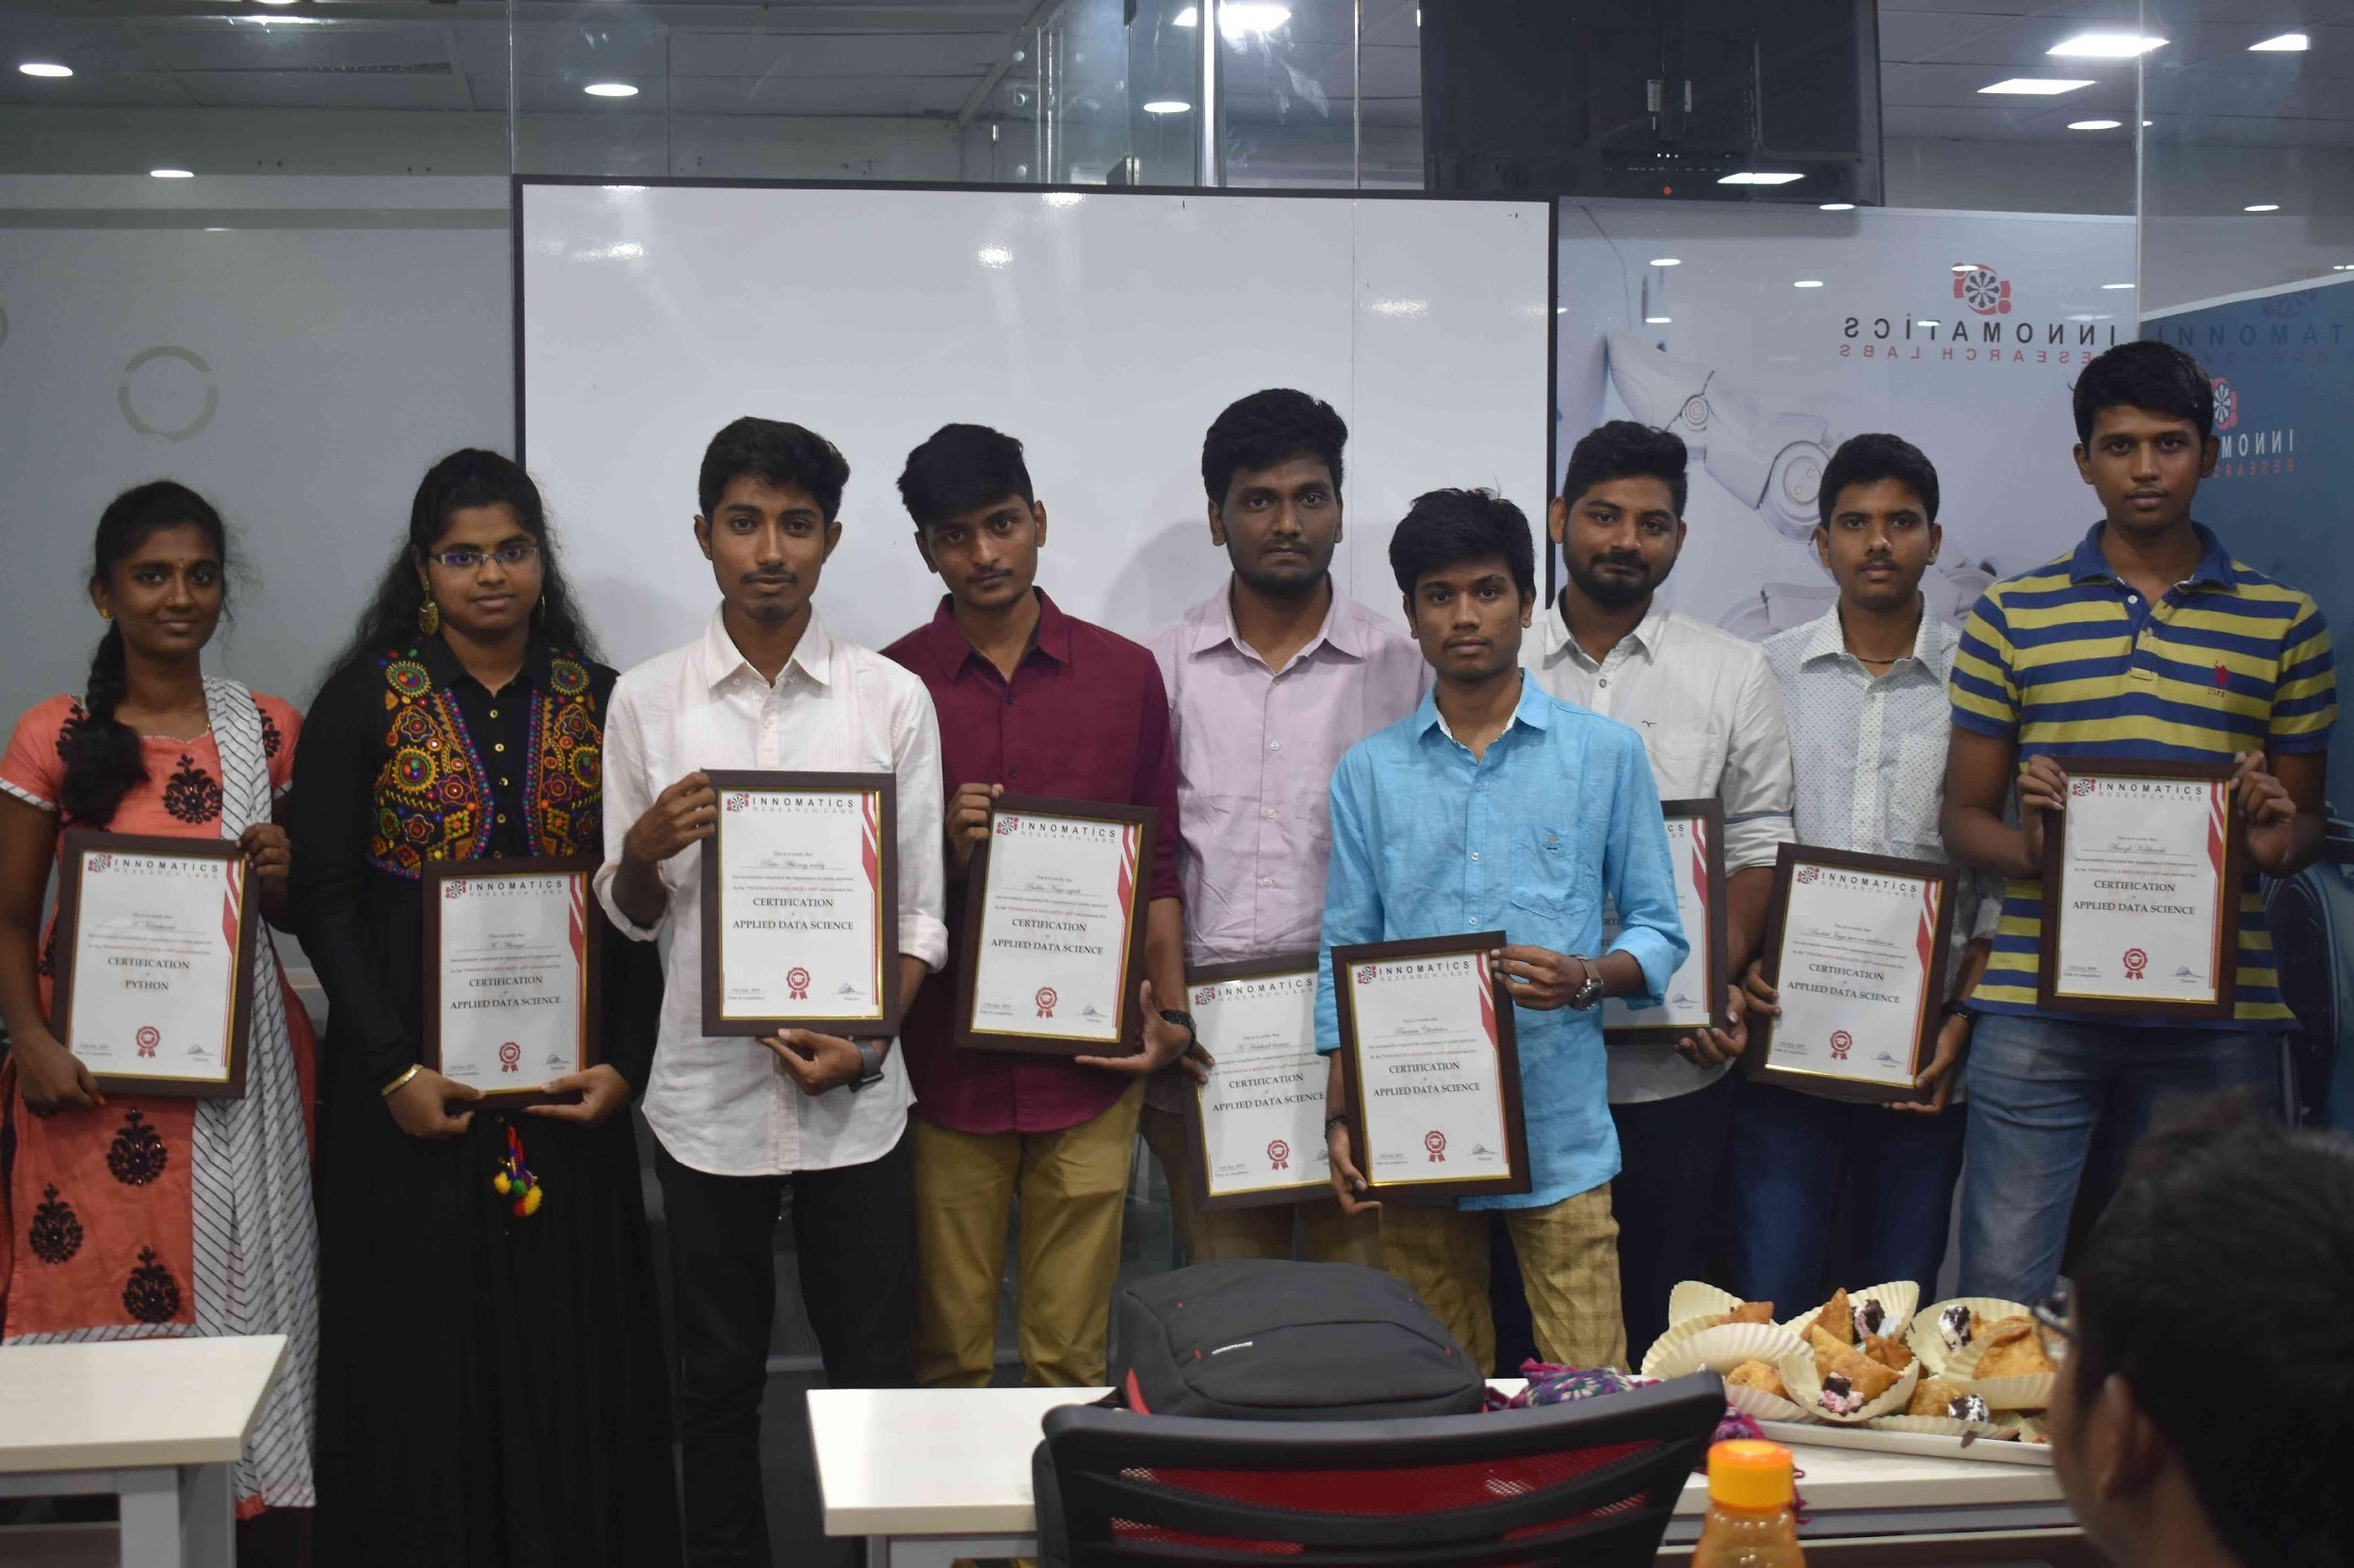
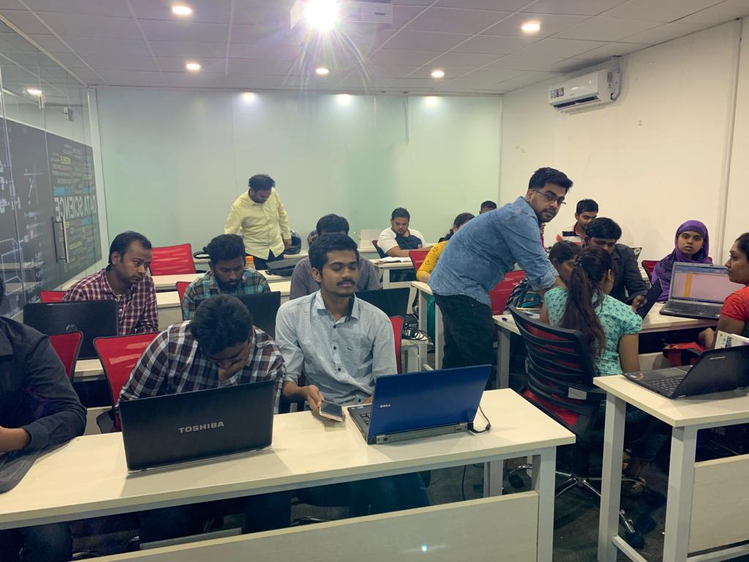

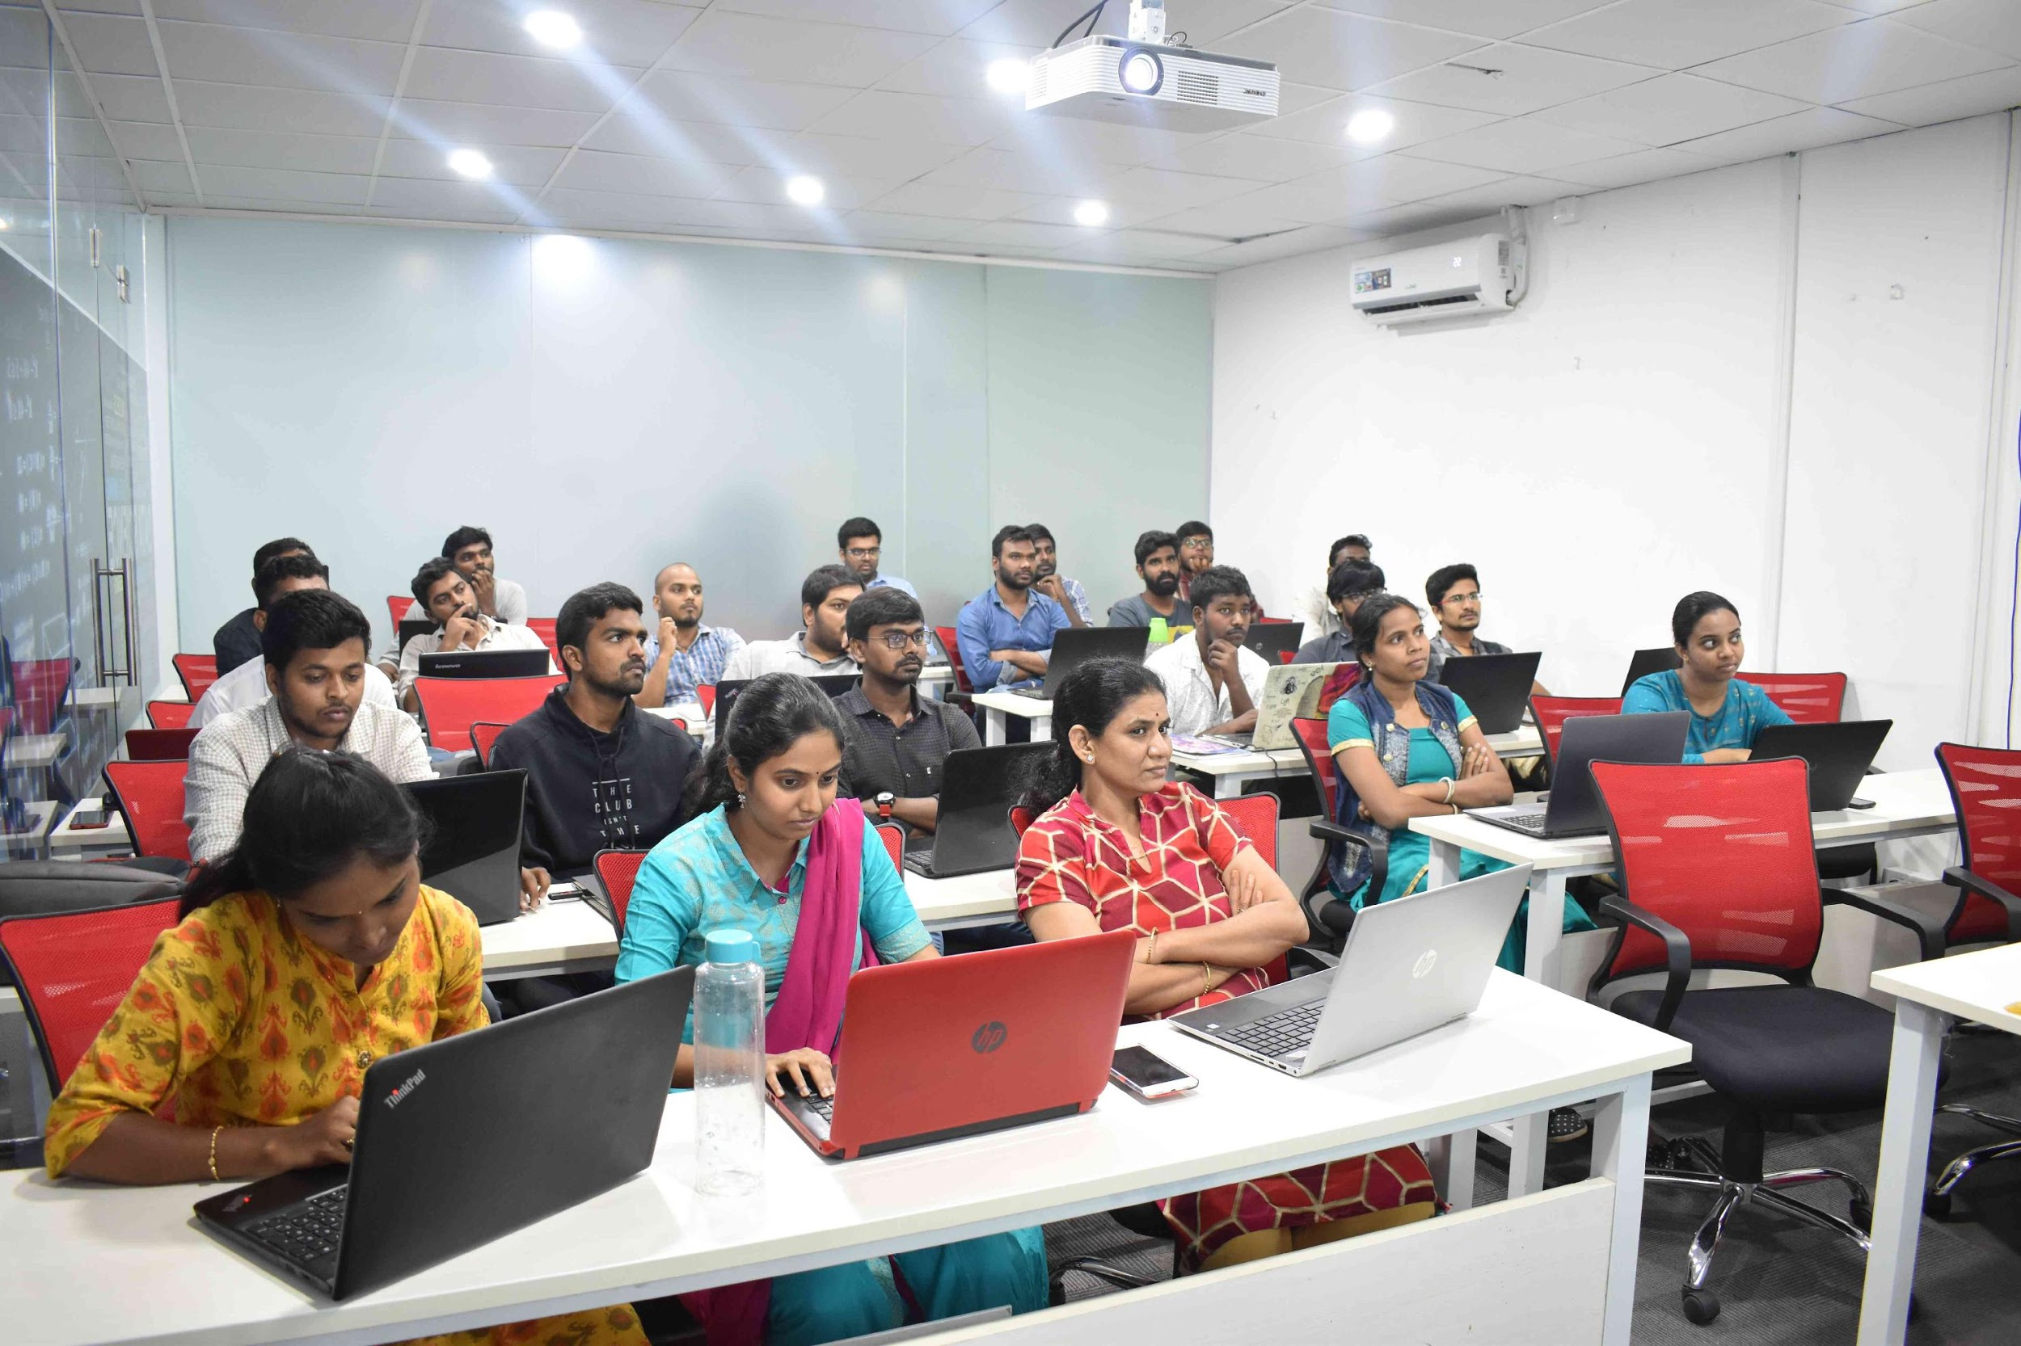



Slide 2
Project on Web-Scraping and EDA
On IMDB Top 1000 high Rated Movies

Slide 3
About me
Myself My name is Mysar Ahmad Bhat . I am pursuing b.tech in (cse) From PTU.
I am a Fresher I have no experience . I am just learning the new things.
The reason I choose data science because it is in the great demand . It hailed as the sexiest job of 21st century.
The main thing that I love about Innomatics is the Friendly behaviour towards the students.

Slide 4
Agenda
Choose the Website
web scraping
EDA
Visualization

Slide 5
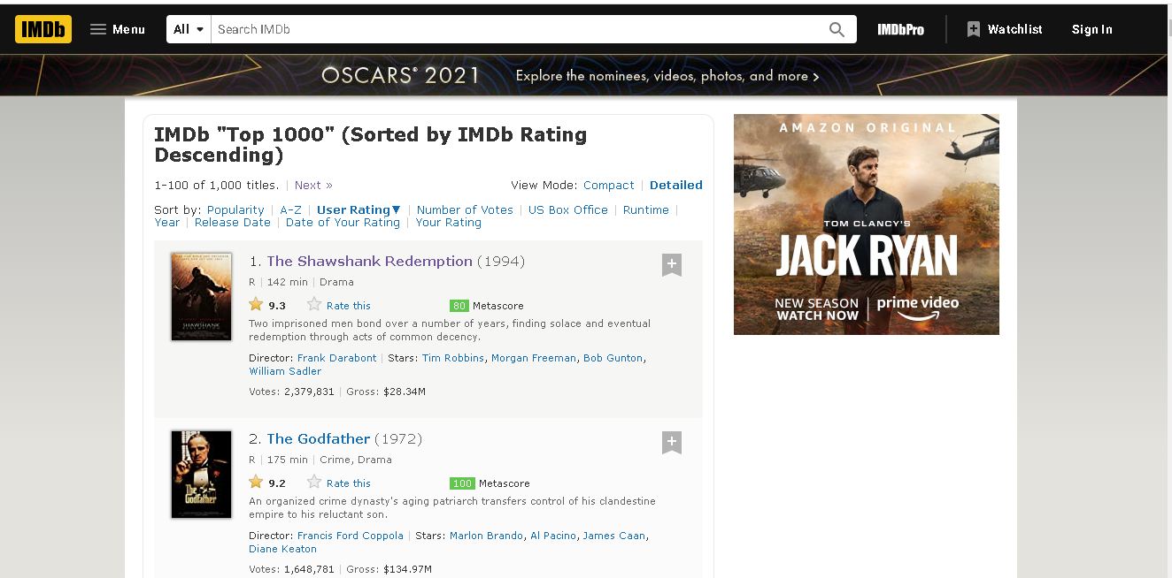
i) ABOUT WEBSITE:
IMDB – Internet Movie Database. Is a website which provides us information about millions of Films and Television programs as well as their cast and crew.

Slide 6
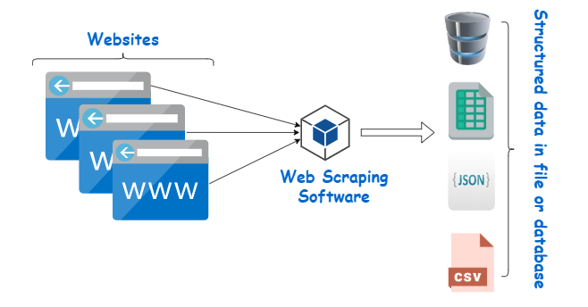
ii) What is web scraping?
web scraping is a technique to extract large amount of data from websites whereby the data is extracted and save to a local file in your computer or a database.
It focuses on transformation of unstructured data on the web , into structured data that can be stored and analyzed.

Slide 7
Packages and tools:
Use BeautifulSoup for parsing:
Beautiful Soup is a Python library for getting data out of HTML, XML, and other markup languages.
Say you've found some webpages that display data relevant to your research, such as date or address
information, but that do not provide any way of downloading the data directly.
Provide simple method to-
Search
Navigate
select
Requests:
The requests module allows you to send HTTP requests using Python.
The HTTP request returns a Response Object with all the response data (content, encoding, status, etc)
Regex:
A Regex or Regular Expression, is a sequence of characters that forms a search pattern.
Regex can be used to check if a string contains the specified search pattern.

Slide 8
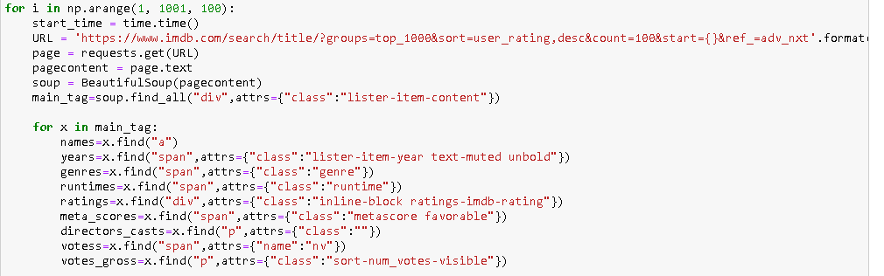
After Completing web-scrapping .

Slide 9
iii) EDA(Exploratory Data Analysis):
also known as Data Exploration, is a step in the Data Analysis Process, where a number of techniques are used to better understand the dataset being used.
Steps in EDA:
Understanding Your Variables
Cleaning your dataset
i) Removing Redundant variables
ii) Variable Selection
iii) Removing Outliers
iv) impute missing values
3. Analysis
i) univariate
ii) bi-variate
iii) Multi-variate

Slide 10
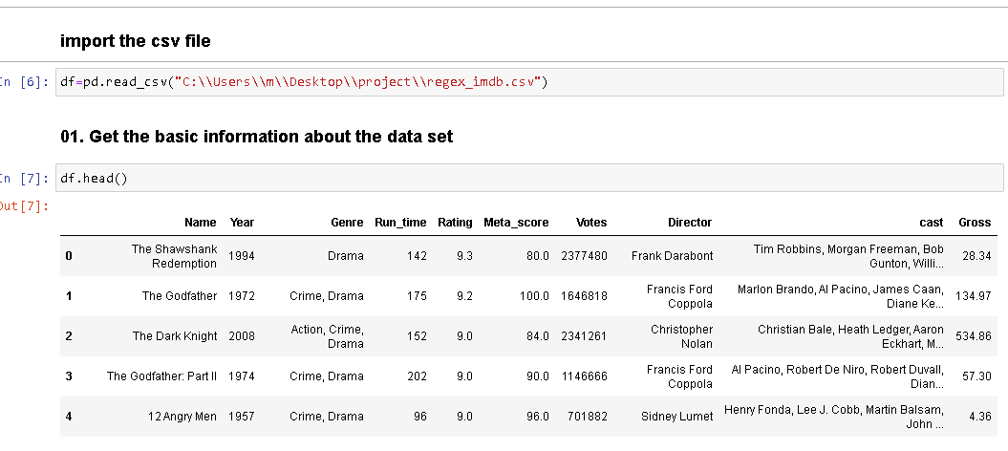
Import the Data SET:

Slide 11
iv) Data Visualization
Data visualization is the discipline of trying to understand data by placing it in a visual context so that patterns, trends and correlations that might not otherwise be detected can be exposed.
Libraries Used:
- Matplot: Matplotlib is specifically good for creating basic graphs like line charts, bar charts, histograms and many more
- Seaborn: Seaborn is a Python data visualization library based on matplotlib. It provides a high-level interface for drawing attractive and informative statistical graphics

Slide 12
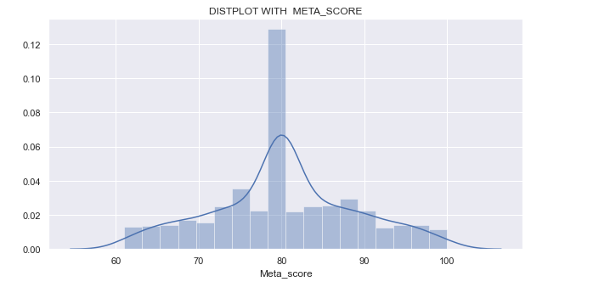
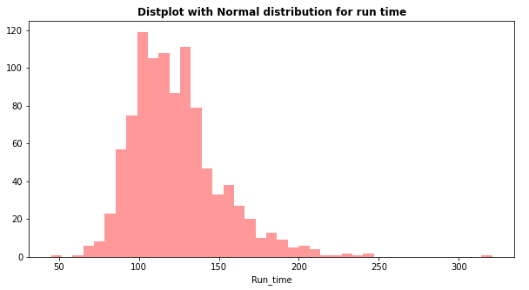
Uni-variate- Analysis:

Slide 13
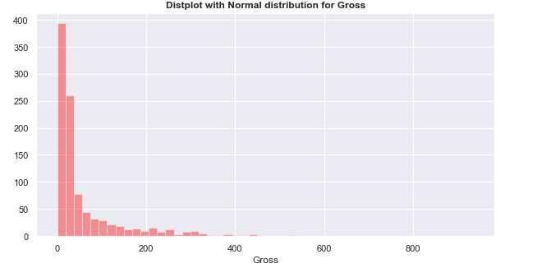
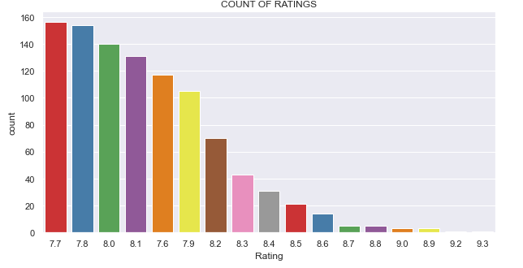

Slide 14
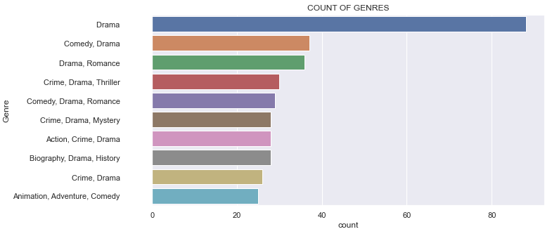
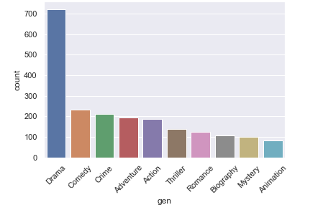

Slide 15
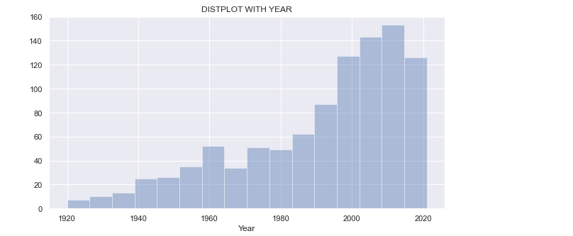
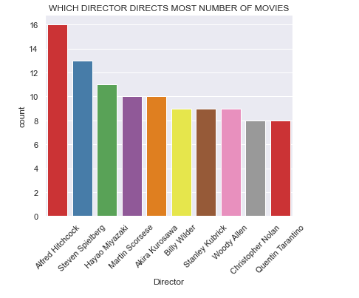

Slide 16
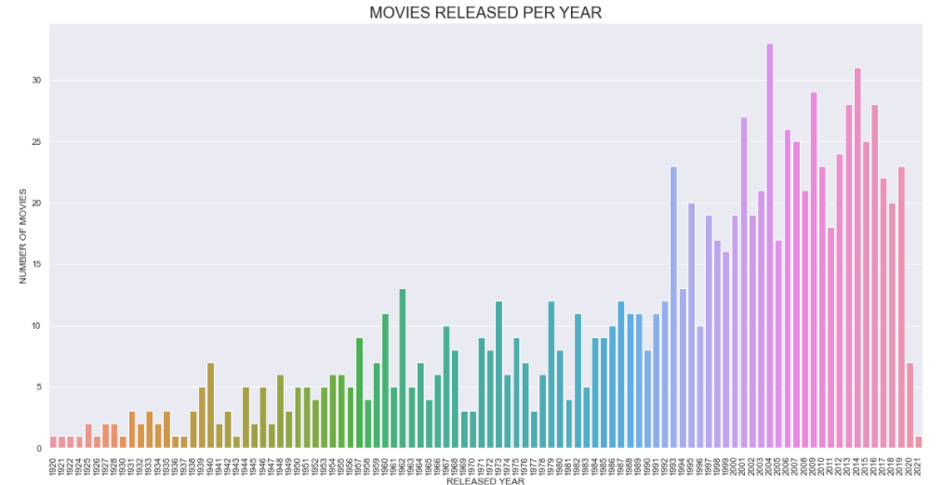

Slide 17
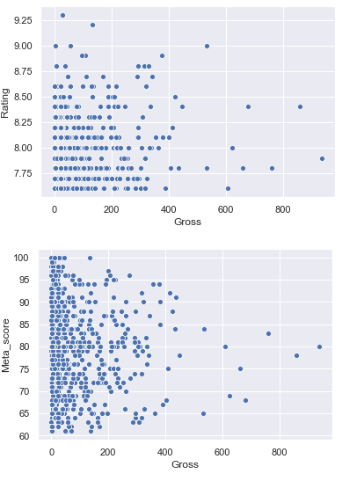
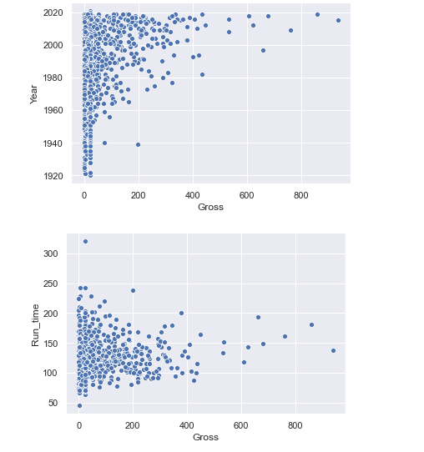
Bi-Variate Analysis:

Slide 18
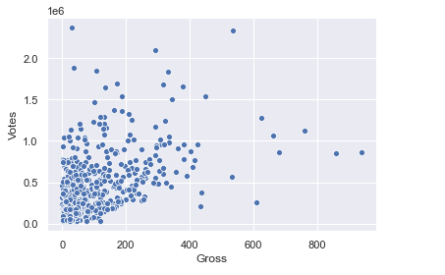

Slide 19
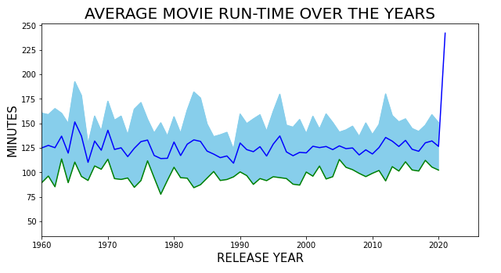
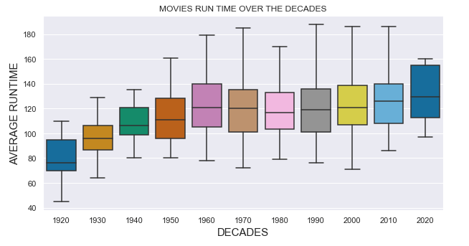

Slide 20
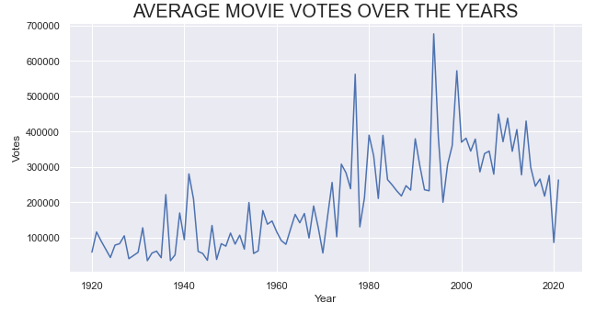
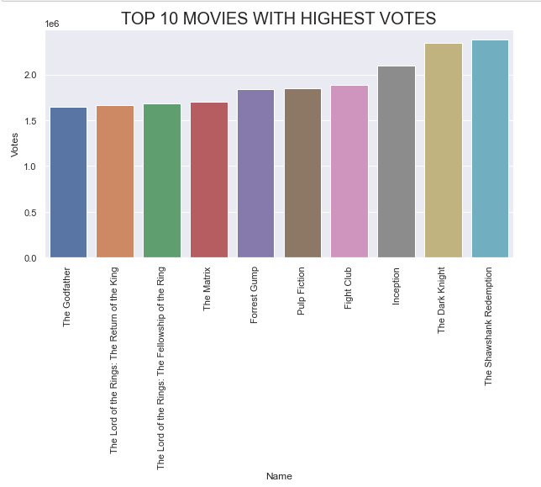

Slide 21
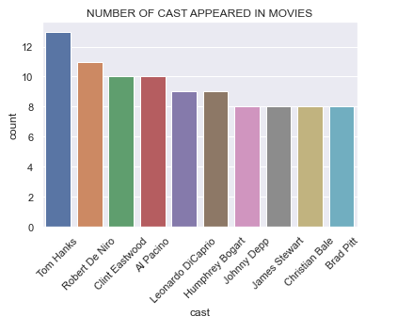

Slide 22
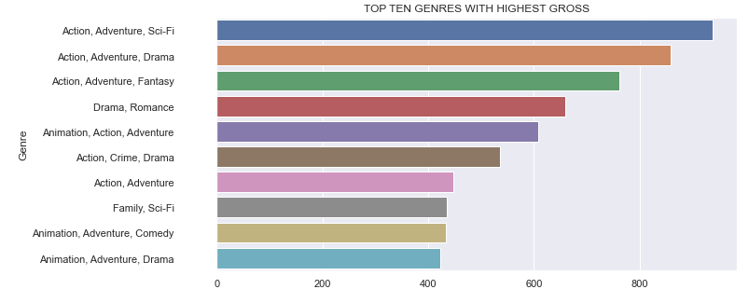
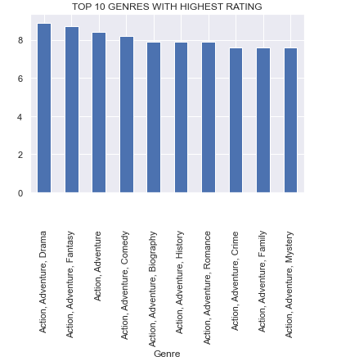

Slide 23
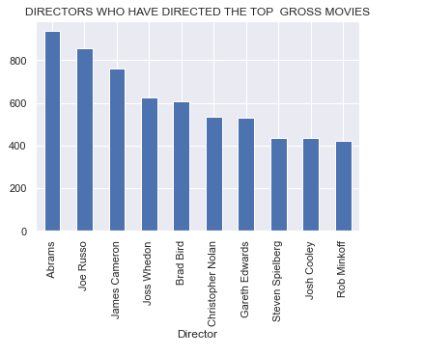
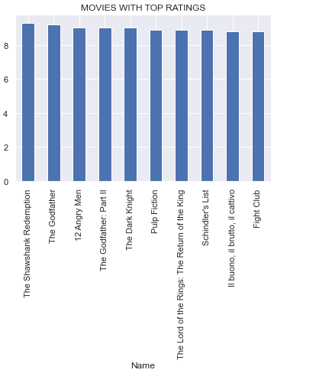

Slide 24
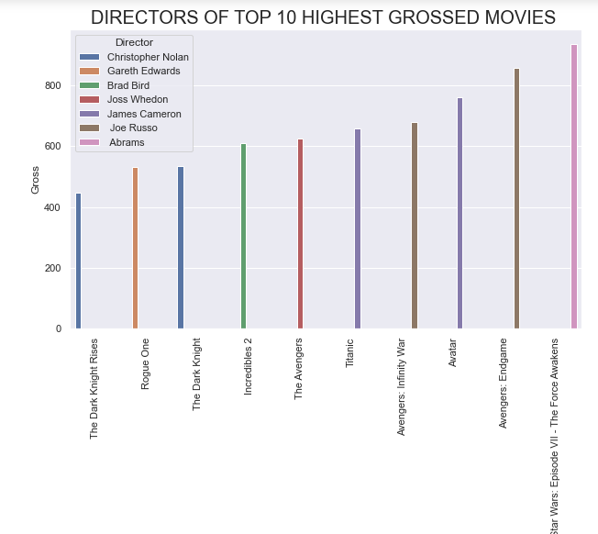
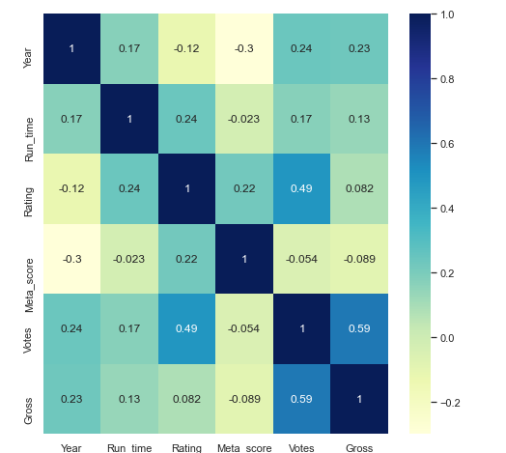
Multi –Variate Analysis:

Slide 25
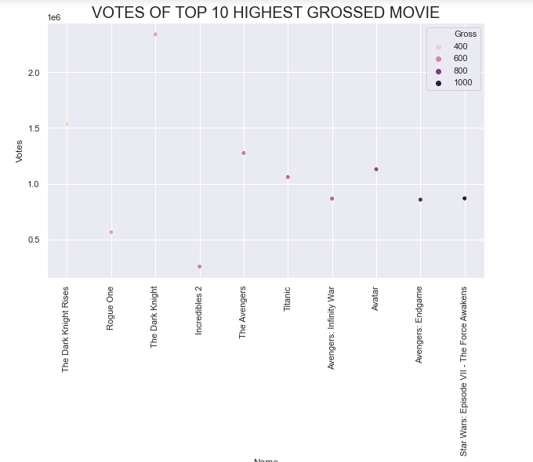
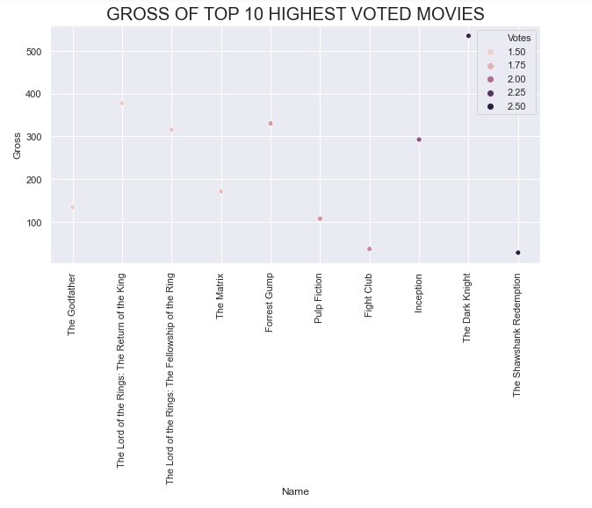

Slide 26
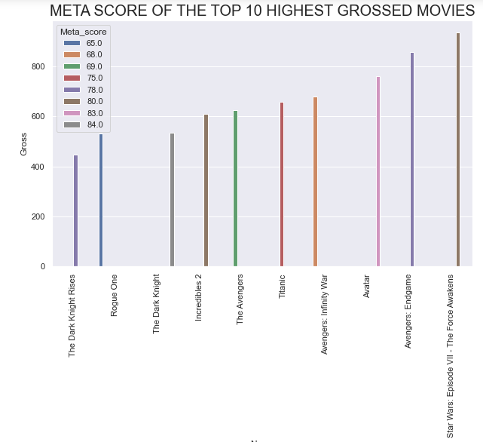
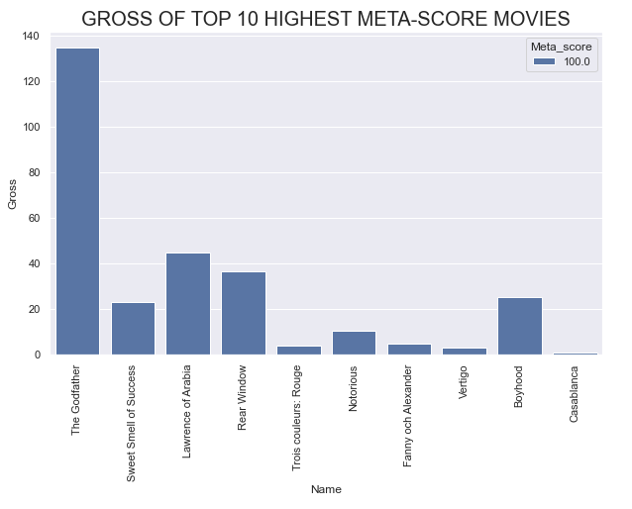

Slide 27
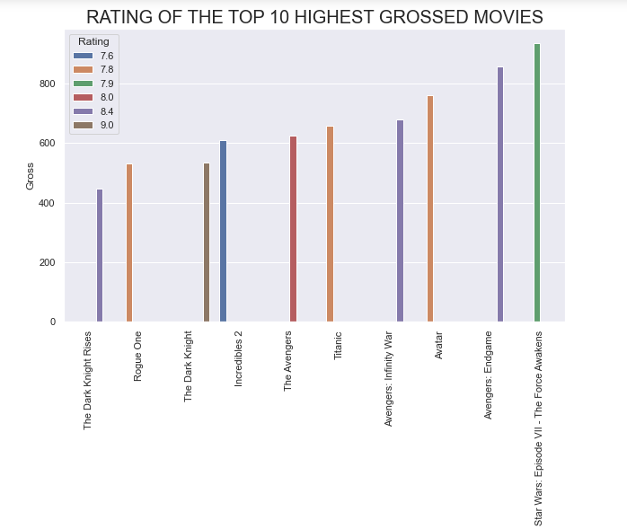
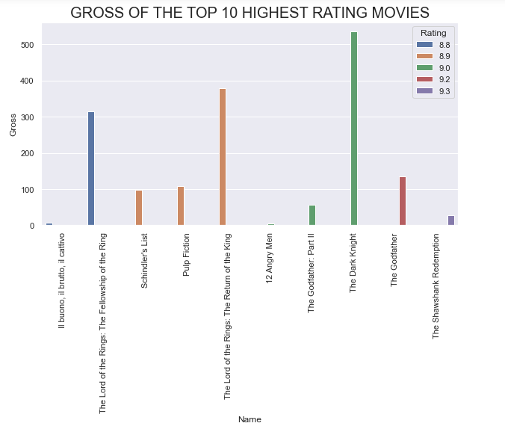

Slide 28
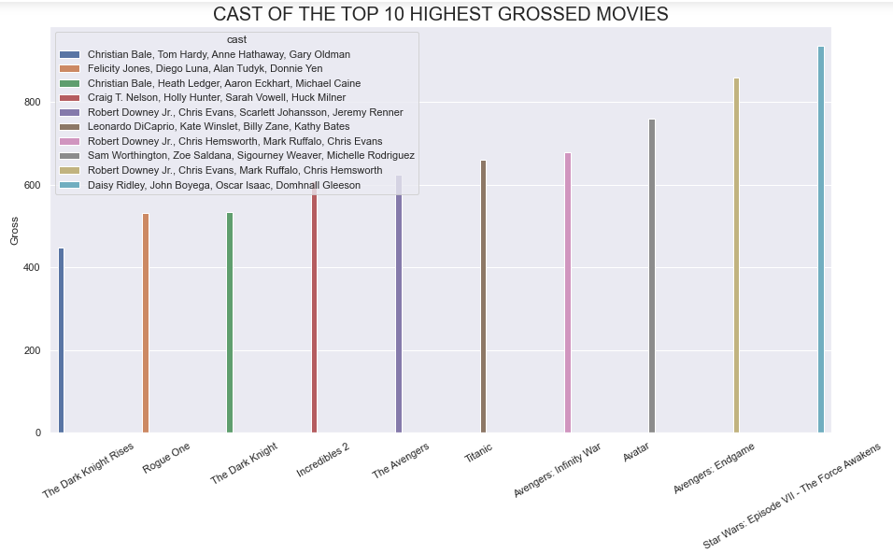

Slide 29
CONCLUSION:
Based on this analysis we can predict which movie will make good money in the box office.
Genre: If the Genre of movie is action , adventure or scifi . Then it have high chances of to make good money in box office.
Director: If the top Directors like Abrams will direct the movie .then it also have good chances .
Cast: It also plays main role for the box office.
Also one more thing that I want to add is that based on this analysis we can make a recommendation system.
If the user is watching some particular movie we can recommend user the movies of the same genre and cast and director

Slide 30

THANK YOU

